Slide 1
Monster Mini-Text Game
Landon Montecalvo

Slide 2
Description of Project
My project is a simple python text game. The player can choose to fight one of the three monsters, and if they beat it, they can select another one to fight. As the player progresses through the different fights, their health and minimum possible attack damage increases, which makes it possible to fight more difficult monsters.
This project includes all of the topics that we covered in class and also many more. Some of these include, imports, functions, lists, and for loops.

Slide 3
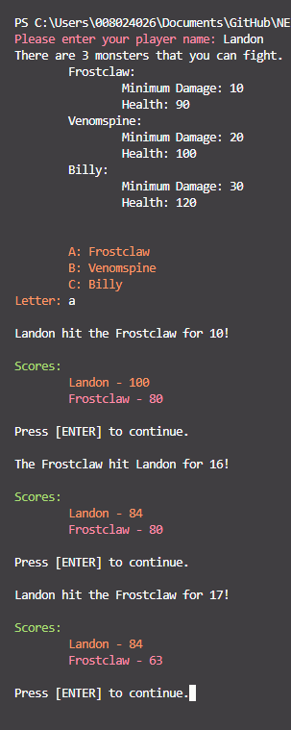
How did I decide on this project?
There are tons of different ideas that I could have decided on for this project. I wanted to make a text game as it would be an interesting and fun way to tie in all of the python functions that we have used in this module.

Slide 4
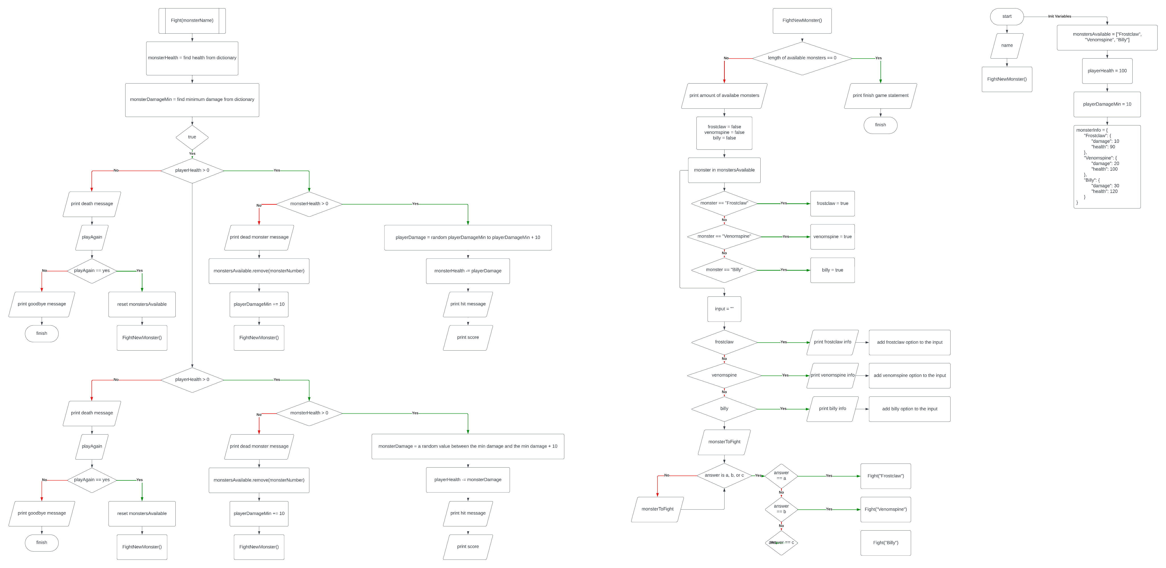
Final Project Flowchart
Flowchart Link

Slide 5
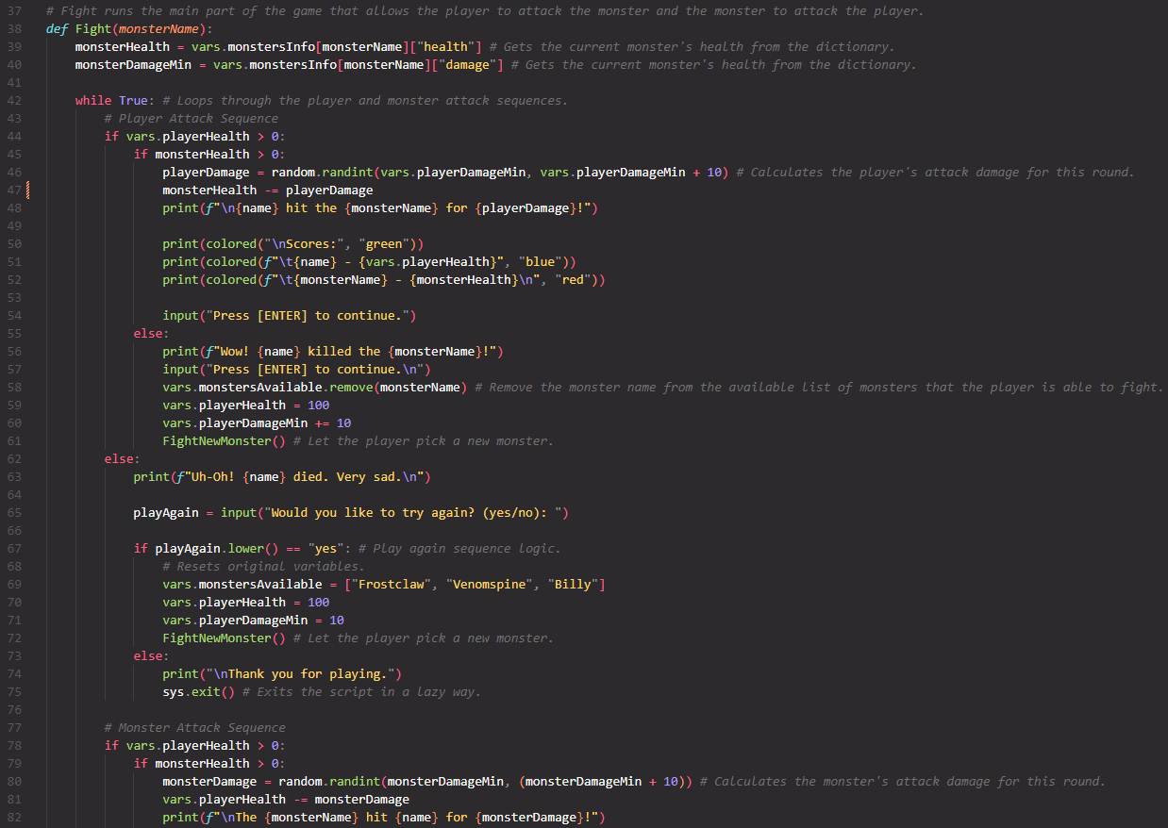
Snapshot of Code

Slide 6
What would I change?
If I could go back and change something about this project, I would probably add more things that the player could do instead of just attack the monster. An example of this could be collecting items. I would also work to make the code more efficient by using classes or more modular functions.

Slide 7
What am I most proud of?
Function Usage
Route that the program takes through the code.

